Slide 1
Home SecurityX

Slide 2
Contents
Introduction to Project
Problem Formulation
Stuffs Used
Applications
Conclusion
Future Scope
References

Slide 3
Introduction to Project
IN TODAY’S WORLD SECURITY IS THE MOST IMPORTANT PART OF EVERY PLACE. SO WE HAVE CAME UP WITH A ULTRA LOW COST AND PORTABLE SECURITY MODULE “HOME SECURITY X”, THAT CAN BE INSTALLED ANYWHERE AND THROUGH IT WE CAN AUTOMATICALLY GET THE PHOTO WHENEVER ANY INTRUDER COMES IN FRONT OF IT IN OUR TELEGRAM APP THROUGH OUR DESIGNED PERSONALIZED TELEGRAM BOT.
IF THIS IS PRINTED IN A PCB BOARD AND LARGE SCALE PRODUCTION IS DONE IT CAN BE USED PROFITABLY IN EVERY HOUSES TO PROTECT FROM THEFT AND ROBBERY AS WELL AS GET PHOTOS OUTSIDE THE HOUSE WHENEVER NEEDED JUST THROUGH SOME CLICKS ON THE TELEGRAM BOT.

Slide 4
Problem Formulation
Here we are targeting the low income families who cannot afford sophisticated and costly security systems for their home and frequently suffer great losses due to robberies and thefts.
Financial and various potential threat to a person can be easily tackled by this device.
This device if produced in large scale can be priced around Rs.500 which will be feasible for most of the people of our country and if further enhancement like direct data transfer to the nearby police station, alert alarm and others are added then it will be more feature savvy as well as giving wide range of protection.

Slide 5
Description of all the Stuffs used
ESP 32 CAM AI THINKER
MINI PIR MOTION SENSOR
FTDI PROGRAMMER
BREADBOARD
JUMPER WIRES
ARDUINO IDE FOR CODING
TELEGRAM CHATBOT USING BOT FATHER
APPLICATIONS

Slide 6
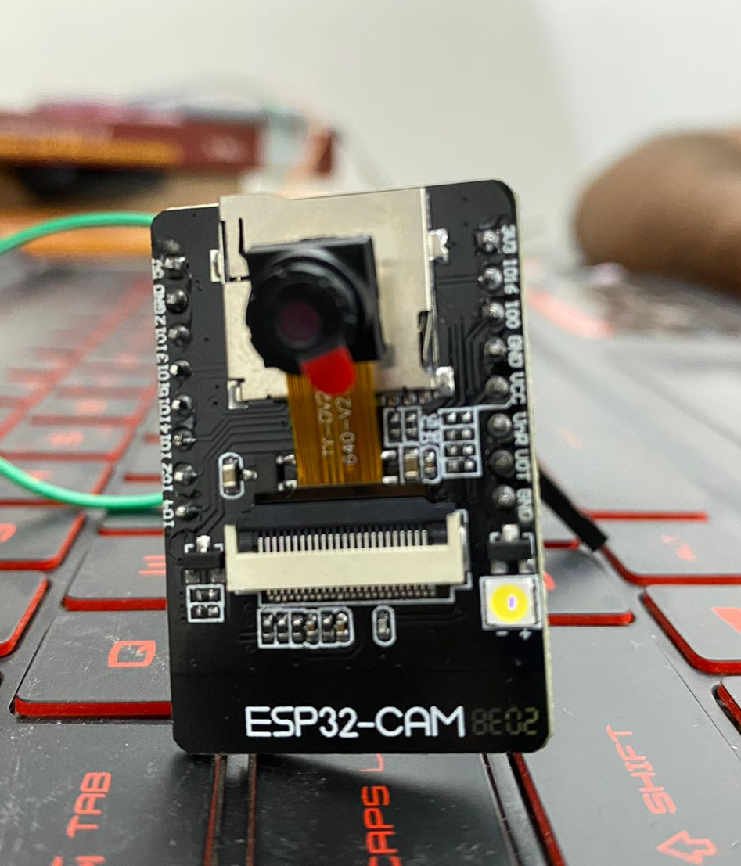
ESP-32 CAM AI THINKER

Slide 7
ESP-32 CAM AI THINKER
The ESP32-CAM AI-Thinker module is an ESP32 development board with an OV2640 camera, microSD card support, on-board flash lamp and several GPIOs to connect peripherals.
ESP32-CAM is the latest small size camera module released by Essence. The module can work independently as the smallest system, with a size of only 27*40.5*4.5mm, and a deep sleep current as low as 6mA.
ESP32-CAM can be widely used in various IoT applications, suitable for home smart devices, industrial wireless control, wireless monitoring, QR wireless identification, wireless positioning system signals and other IoT applications. It is an ideal solution for IoT applications .

Slide 8
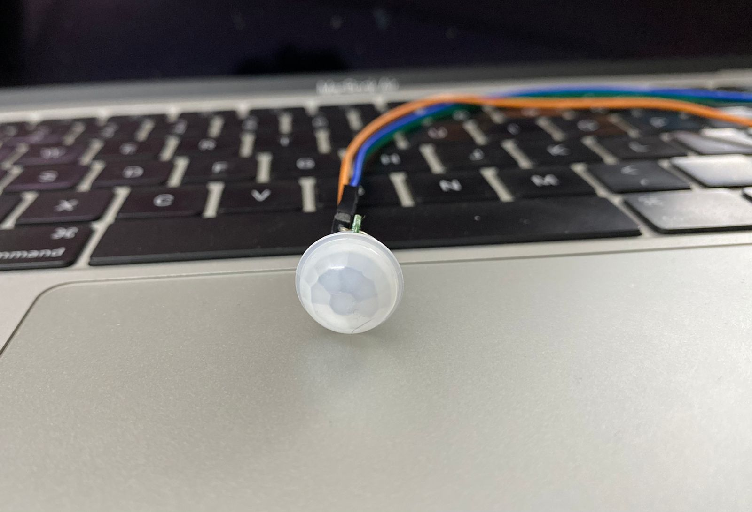
Mini PIR Motion Sensor

Slide 9
Mini PIR Motion Sensor
PIR sensors enables us to sense motion, nearly always wont to sight whether or not a person's has affected in or out of the sensors range. they're small, inexpensive, low-power, simple to use and don't wear out. For that reason they are usually found in appliances and gadgets employed in homes or businesses. they're usually stated as PIR, "Passive Infrared", "Pyroelectric", or "IR motion" sensors.

Slide 10
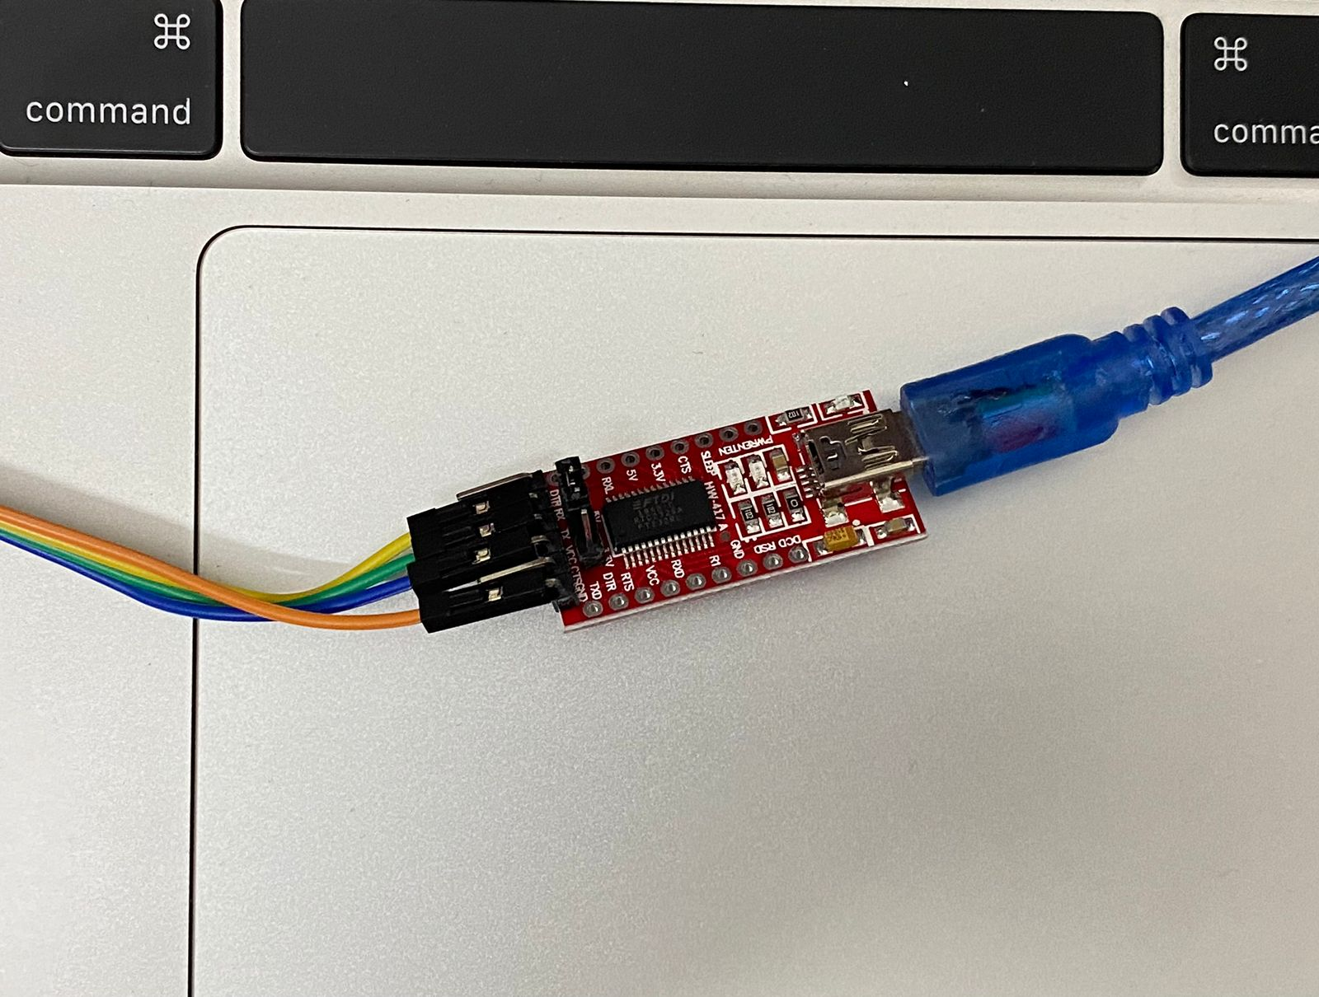
FTDI Programmer

Slide 11
FTDI Programmer
The FTDI USB to TTL serial convertor module could be a UART (universal asynchronous receiver-transmitter) board used for TTL serial communication. it's popularly used for communication to and from microcontroller development boards love ESP-01s and Arduino micros, that don't have USB interfaces.

Slide 12
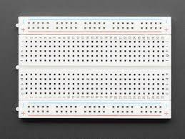
BREADBOARD

Slide 13
Breadboard
A bread board could be a solderless device for temporary prototypes with physics and take a look at circuit designs. Most electronic parts in electronic circuits is interconnected by inserting their leads or terminals into the holes and so creating connections through wires wherever appropriate.
A breadboard is used to build and test circuits quickly before finalizing any circuit design. The breadboard has many holes into which circuit components like ICs and resistors can be inserted.

Slide 14
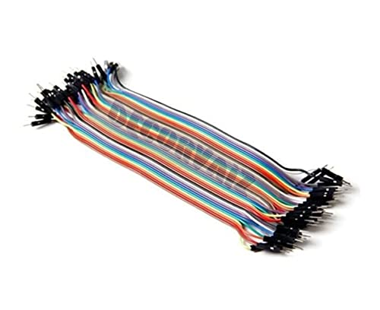
Jumper Wires

Slide 15
Jumper wires
A jump wire is Associate in Nursing electrical wire or cluster of them in a very cable with a connection or pin at each end. Wires are wont to connect elements to every alternative on the board or other prototypes, internally or with other instrumentation or components, while not soldering.

Slide 16
Arduino IDE for Coding
Arduino IDE is a special software running on your system that allows you to write sketches (synonym for program in Arduino language) for different Arduino boards.
The Arduino programming language is based on a very simple hardware programming language called processing, which is similar to the C language.

Slide 17
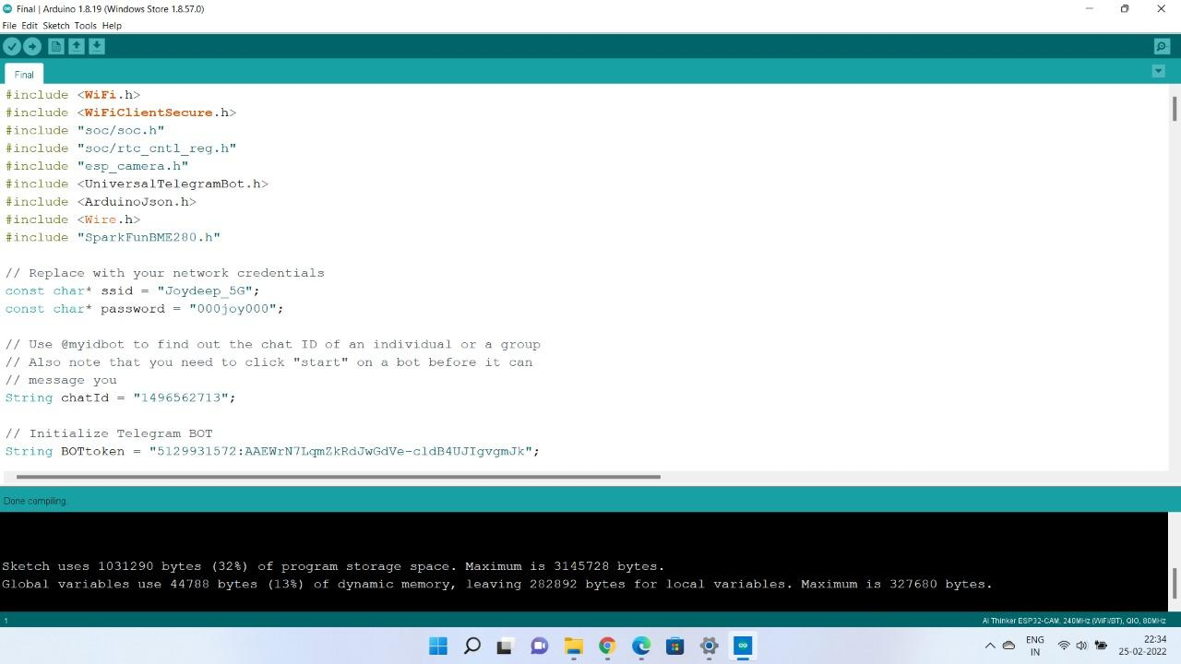
CODE SNAPSHOT

Slide 18
Chatbot Making
A chatbot system uses conversational artificial intelligence (AI) technology to simulate a discussion (or a chat) with a user in natural language via messaging applications, websites, mobile apps or the telephone. It uses rule-based language applications to perform live chat functions in response to real-time user interactions.

Slide 19
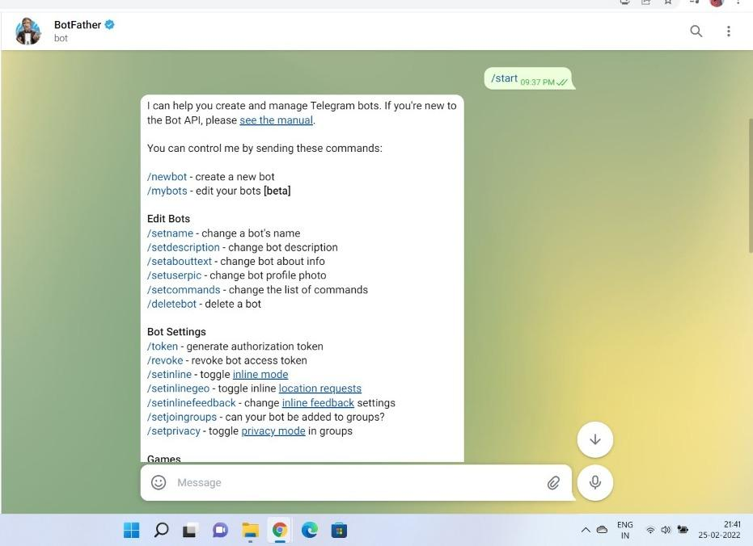
Chatbot for Telegram

Slide 20
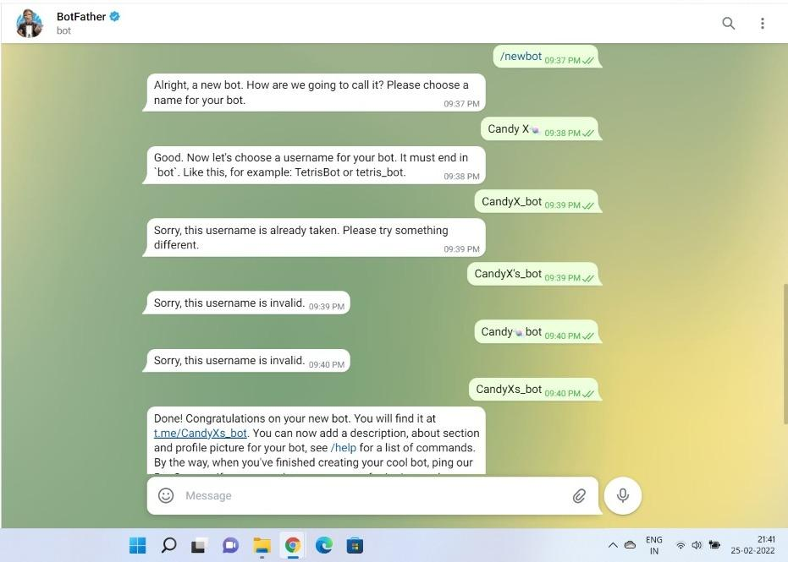
Chatbot for Telegram

Slide 21
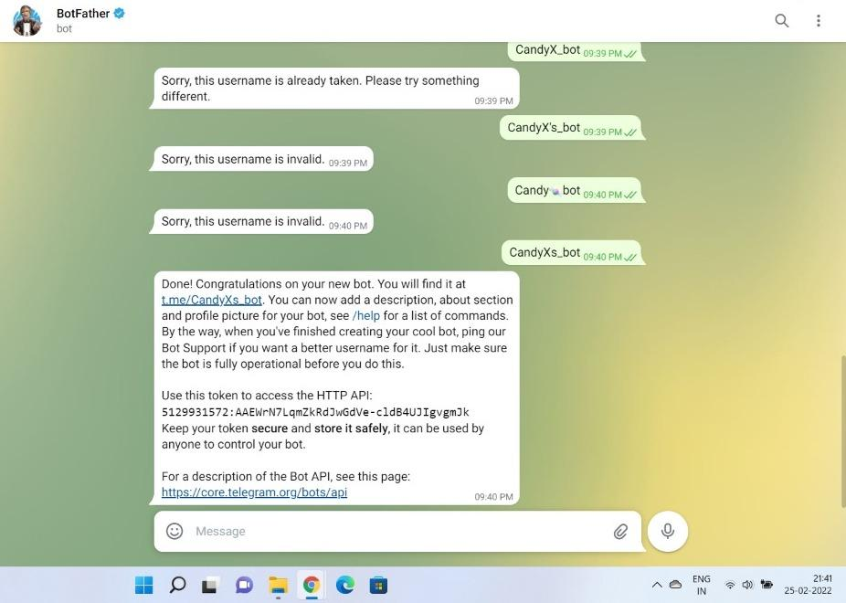
Chatbot for Telegram

Slide 22
Chatbot for Telegram

Slide 23
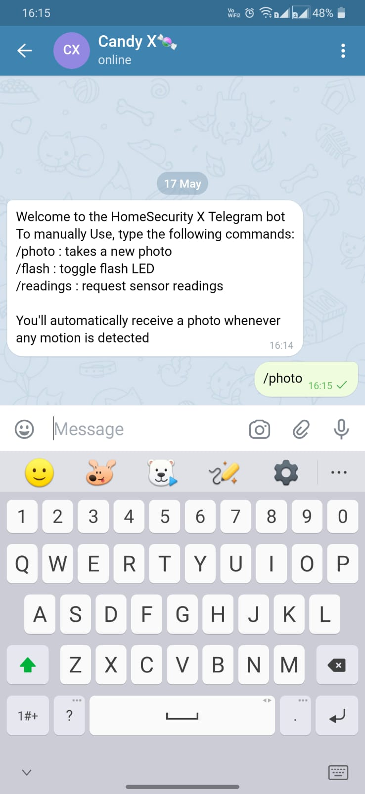
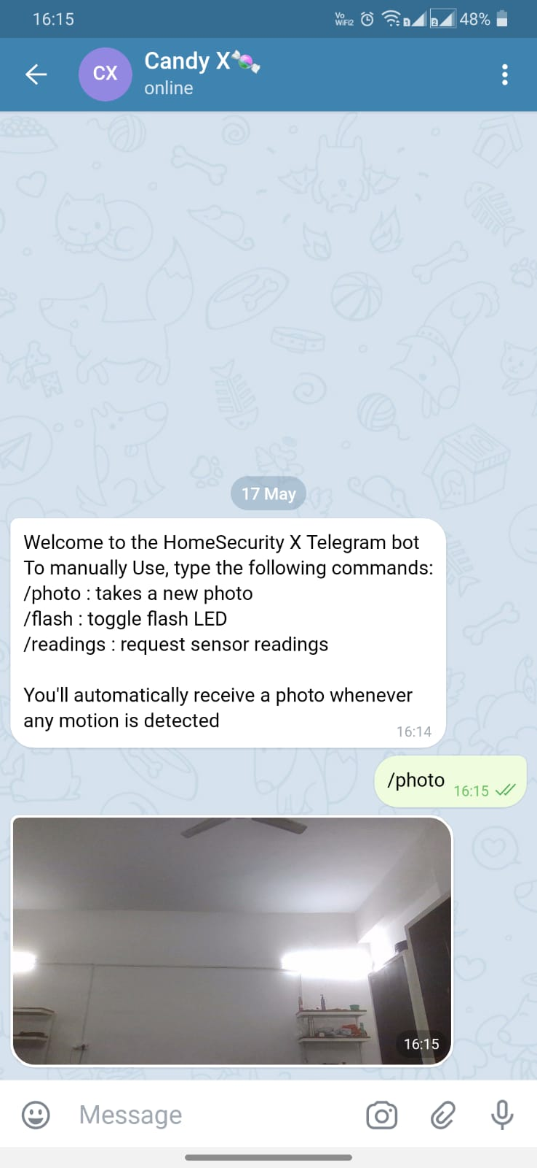
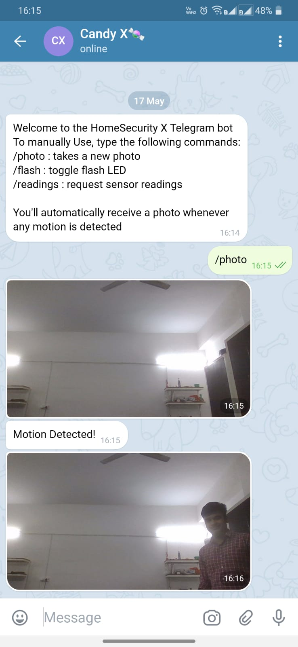
Chat Bot Working

Slide 24
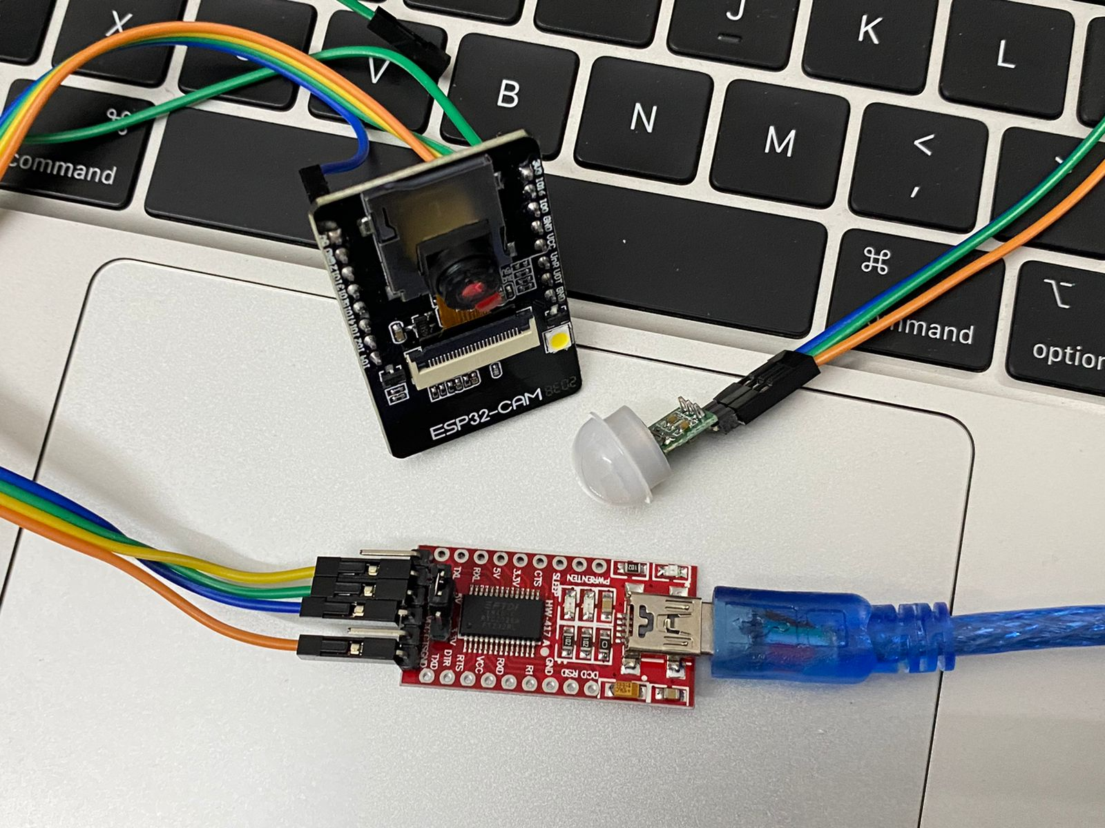
Total Circuit

Slide 25
APPLICATIONS
This is a multi purpose Security that can be used:
Outside shops Houses to protect from theif
Protecting Farm from animals and birds
As birds eye view outside house
See what's happening outside without going into the spot
Spy Camera

Slide 26
Conclusion
This project is a promising low cost, portable hardware based security solution which will be helpful in stopping crimes, thefts, robberies as well as protecting house surroundings.
It can also be implemented on farms and agriculture sector to protect the crops from various insects, pests and animals thus getting a good yield.
If this system is printed on a PCB board to make it more portable and produced in large scale it will come below 500INR which will be feasible for most of the people to use.
Further research and modification can make it better.
Any suggestion, feedback or improvement note is highly appreciated.

Slide 27
Future Scope
Printing into PCB board for portability
Adding more features like night vision, local help centers emergency data transfer.
Data Security tightening.

Slide 28
References
https://www.waveshare.com/wiki/ESP32-CAM
https://ftdichip.com/utilities/
https://learn.adafruit.com/pir-passive-infrared-proximity-motion-sensor
https://www.arduino.cc/
https://sendpulse.com/knowledge-base/chatbot/create-telegram-chatbot

Slide 29


